Slide 1
Bioinformatics 2021
Lecture 2

Slide 2
Central dogma
Replication
Transcription
Translation
Splicing
https://www.youtube.com/watch?v=gG7uCskUOrA

Slide 3
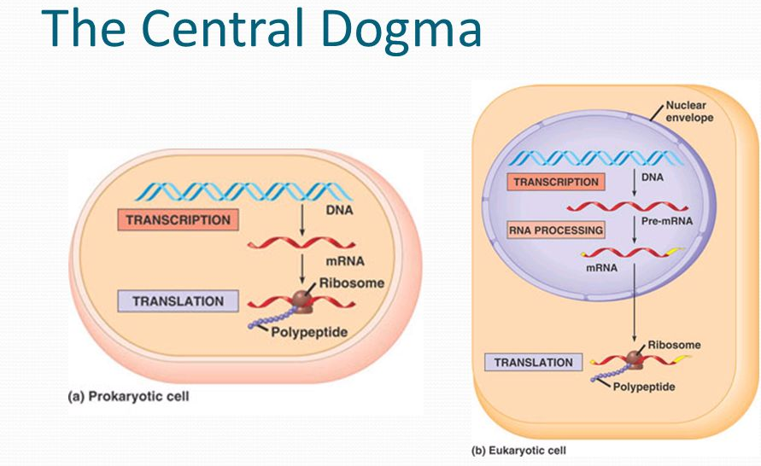
Basic cellular mechanisms of life
DNA
Replication
Decoding of the genetic code
RNA
Transcription
Proteins
Translation

Slide 4
Activity 1
Calculate the total number of cells in a 50 kg person
This is an approximate calculation for illustration purpose
Cell dimension is 10 um in diameter for a sphere
Assumptions
Assume the cell to be cubical in shape[although spherical is more appropriate]
For conversion use 1dm³ = 1 l = 1 kg.

Slide 5
Activity 1
Q: How many cells are there approximately in an average 50 kg person?
10 microns diameter of a cell
Volume = 10 x 10 x 10 um³ = 1 cell [assuming it to be a cube]
So in 1 mm³, there will be about 1 million cells [1 um is 10⁻³mm or 1mm = 10³ mm].
In a dm³ , there will be 10¹² cells – 1 trillion
1 dm³ = 1l = 1kg [assumption]
About 50 trillion cells.
Notes:
5-10min
5

Slide 6
Activity 2
Calculate the length of the DNA
Human DNA- 6.6 * 10⁹ bp
Each base pair – 0.34 nm
Notes:
10min
6

Slide 7
Activity 2
Calculate the length of the DNA
Human DNA- 6.6 * 10⁹ bp
Each base pair – 0.34 nm
About 2m long
Amount of pressure and the level of packaging
Compare the size to that of the cell average is 6um in diameter!!!
Notes:
10min
7

Slide 8
DNA is just a fine, spiral coiled thread in the nucleus of every living cell.
The human genome, encoded as DNA, contains 23 chromosome pairs, which is like 500 thousand to 2.5 million nucleotide pairs.
What if it were to be stretched or coiled? Every human being has about ten trillion cells in their body. If all DNA cells are stretched, they can go as far as 744 million miles. Now the moon is only about 2,50,000 and the Sun is 93,000,000 miles away.

Slide 9
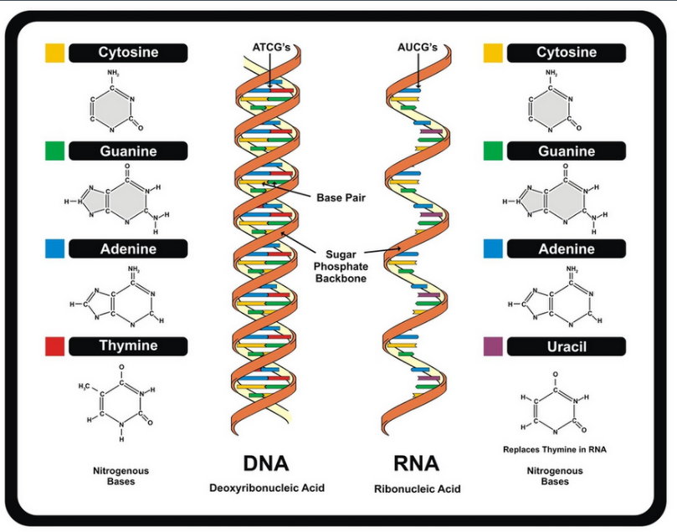
Structure of DNA/ RNA
Double helix
Consists of 4 base pairs
Sugar- Phosphate backbone
Colored blocks are the bases.
There are 2 strands of the backbone that runs in opposite direction
The bases on the 2 strands base pair

Slide 10
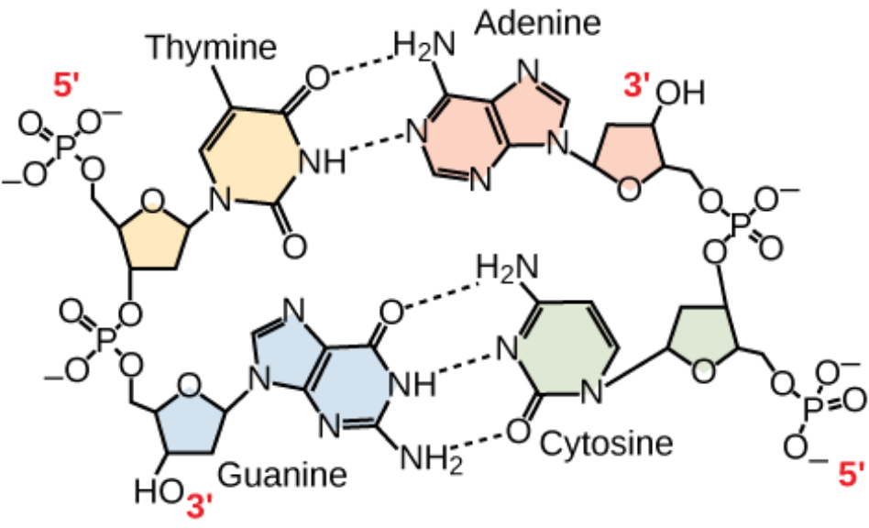
The rules pertaining to the basic DNA structure
There are 4 bases- Adenine [A], Guanine[G], Thymine [T], Cytosine [C].
A pairs with T [2 H-bonds]
G pairs with C [3 H-bonds]
Note!!!
The 2 strands are anti-parallel to each other.
Observe the sugar-Phosphate backbone to understand
------
Other terminologies- Complementary strands

Slide 11
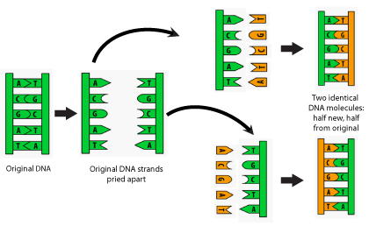
Replication- Making copies of DNA
Simple steps
Helicases- Unwinds DNA
Polymerases- Creates Complementary strand

